Slide 1
Predicting risk of type 2 diabetes
UC Irvine Data Science Capstone Project - Engaging and preparing university students by focusing on solving real-world challenge facing local community

Slide 2
Agenda
01
UC Irvine Relationship
02
Context
03
Framework & Approach
04
Output & Recommendation
05
Enhancement Opportunities

Slide 3
01
UC Irvine Relationship

Slide 4




UC Irvine Outreach Program
Establish close partnership with a local university for recruiting top talent and working with students on projects, which impact our community and clients and amplify our brand awareness
Recruitment
Career fairs and information sessions
at UCI and specialized schools.
Goal to increase pipeline of diverse
and quality prospects.
Fall recruitment fair is coming up soon!
Campus Events
Ways to bring influential leaders to campus and encourage thought-provoking conversations and the exchange of ideas.
Guest Lecturer opportunities available in Merage's MBA and MSBA programs.
Build a community of UCI Alumni within Accenture to support all the activities.
Capstone Program
Accenture sponsors an undergraduate- or graduate-level capstone project in Merage and ICS every Winter Quarter.
Accenture produces project ideas and students “build” the project over two quarters.
Student gains hands-on, real-world experience in addition to soft-skills.
AI for Good initiative.
Value
Increase quality pipeline for recruitment
Create a positive impact in local community
Work with students to coach the future generation
Create opportunities to build AI Powered Solutions
Public speaking events to increase brand awareness
Copyright © 2022 Accenture. All rights reserved.​

Slide 5

Our Journey
Feb 2021
Apr 2021
Nov 2021
Predicting Wildfire in California
Merage Analytics Club Speaker Event
Guest Lecturer for Graduate Students Machine Learning
July 2022
Feb 2022
Feb 2022
Entry-Level Applications Promoted to UCI
Recruitment Information Session
Predicting Risk for Diabetes in California
Oct – Dec 2022
Jan 2023
April 2023
Fall Recruitment Events
Student Leadership Program Engagements
Spring Recruitment
(if demand exists)

Slide 6







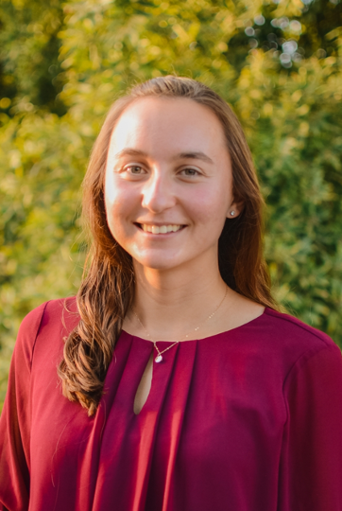
Our Team
Martin Hodgett
Manish Dasaur
Vishrut Chokshi
AAI Resources West
Shawna Tuli
AAI Microsoft West
Jeff Lu
T&O West
Niles Hanov
AAI DS & ML West
Ella Liang
CDP West
Nicole Deacon
CDP West

Slide 7
02
Context

Slide 8
Over 34 million Americans have diabetes and face its devastating consequences.
This community challenge led us to asking two key questions:
1
How can we employ a data and AI based approach to identify and predict diabetes as a first step towards prevention?
How can we turn this study and predictive model into a research-based credential?
California’s diabetes epidemic:
Approximately 3,209,418 people in California, or 10.5% of the adult population, have diagnosed diabetes.
An additional 884,000 people in California have diabetes but don’t know it, greatly increasing their health risk.
Nearly half of adults in California have prediabetes or undiagnosed diabetes.
2
Copyright © 2022 Accenture. All rights reserved.

Slide 9




UC Irvine Data Science Capstone Course
Undergraduate Senior Capstone Project Design and Development
14 weeks
Project-based course for capstone students
This course allows senior students to solve a substantial real-world problem.
Accenture is a sponsor to a project which helps our local community and people.
42
Undergraduate Computer Science students enrolled in course
Feb 21 – June 26
Starting our engagement with students on Feb 16th
50%
Computer Science students are minority, female or first-generation
FY 2022 Challenge – Predicting Risk of Type 2 Diabetes with AI in California FY 2021 Challenge – Predicting Wildfire in California

Slide 10
03
Framework & Approach

Slide 11
Evaluation of Publicly Available Data
Data is at the heart of AI and data quality is key to successful AI
Open Data Sources
700+ Attributes from 12 different areas
Healthier Together
Screening Information
Demographic Information
General Health Condition
Health Behaviors
General Health, Disability & Sexual Health
Women’s Health
Mental Health
Health Insurance
Health Care Utilization/Access
Employment, Income, Poverty Status & Food Security
Public Program Participation
Housing & Community Involvement
California County Statistics
California Health & Human Services
California Health Interview Survey
California Health Interview Survey
Center for Disease Control

Slide 12
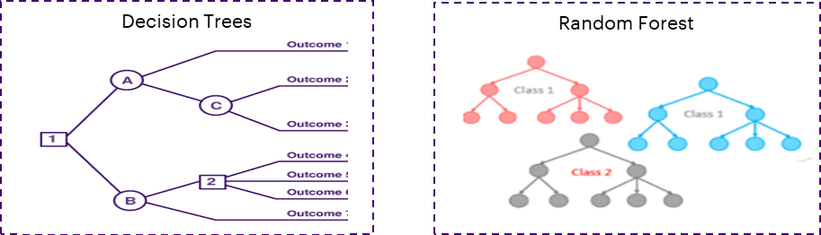


Solution Approach
California Health Interview Survey
Health Insurance
Screening Information
Demographic Information
300+ FEATURE GENERATION
MACHINE LEARNING ALGORITHM
Predictive Model with Test Data Validation
Public Program Participation
………
Draft for Research Paper
Accenture approves before published to BMJ Open Diabetes Research & Care
*Abstract submitted. Detailed Research Paper in progress.
Notes:
Our research explores data-driven approaches which utilize supervised machine learning models to identify patients with such diseases. Using the California Health Interview Survey (CHIS) dataset, we conduct an exhaustive search of all available feature variables within the data to develop models for diabetes detection. Using 9-year time-frames from 2012 to 2020 of 190K individual surveyors and feature sets for the data, multiple machine learning models (logistic regression, support vector machines, random forest, and gradient boosting) were evaluated on their classification performance. Information gain of tree-based models was used to identify the key variables within the patient data that contributed to the detection of at-risk diabetes patients by the data-learned models.

Slide 13
04
Output & Recommendation

Slide 14
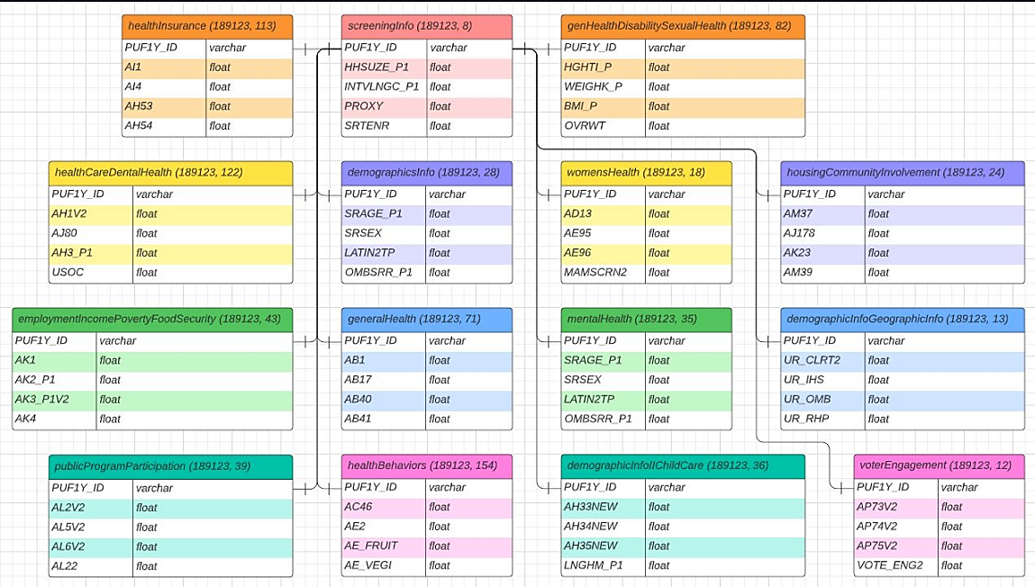
Data Preparation
The first and most important step in an analysis is data preparation. Students followed a 3-step process to obtain the data, format the data, and transform the data so that insightful conclusions could be made.
Data Collection
Data Preprocessing
Data Normalization
Gathering and Combining Data Together
Formatting
Cleansing
Scaling and normalizing
1
2
3
Notes:
One of the reasons that it's easy to get confused between scaling and normalization is because the terms are sometimes used interchangeably and, to make it even more confusing, they are very similar! In both cases, you're transforming the values of numeric variables so that the transformed data points have specific helpful properties. The difference is that, in scaling, you're changing the range of your data while in normalization you're changing the shape of the distribution of your data.

Slide 15
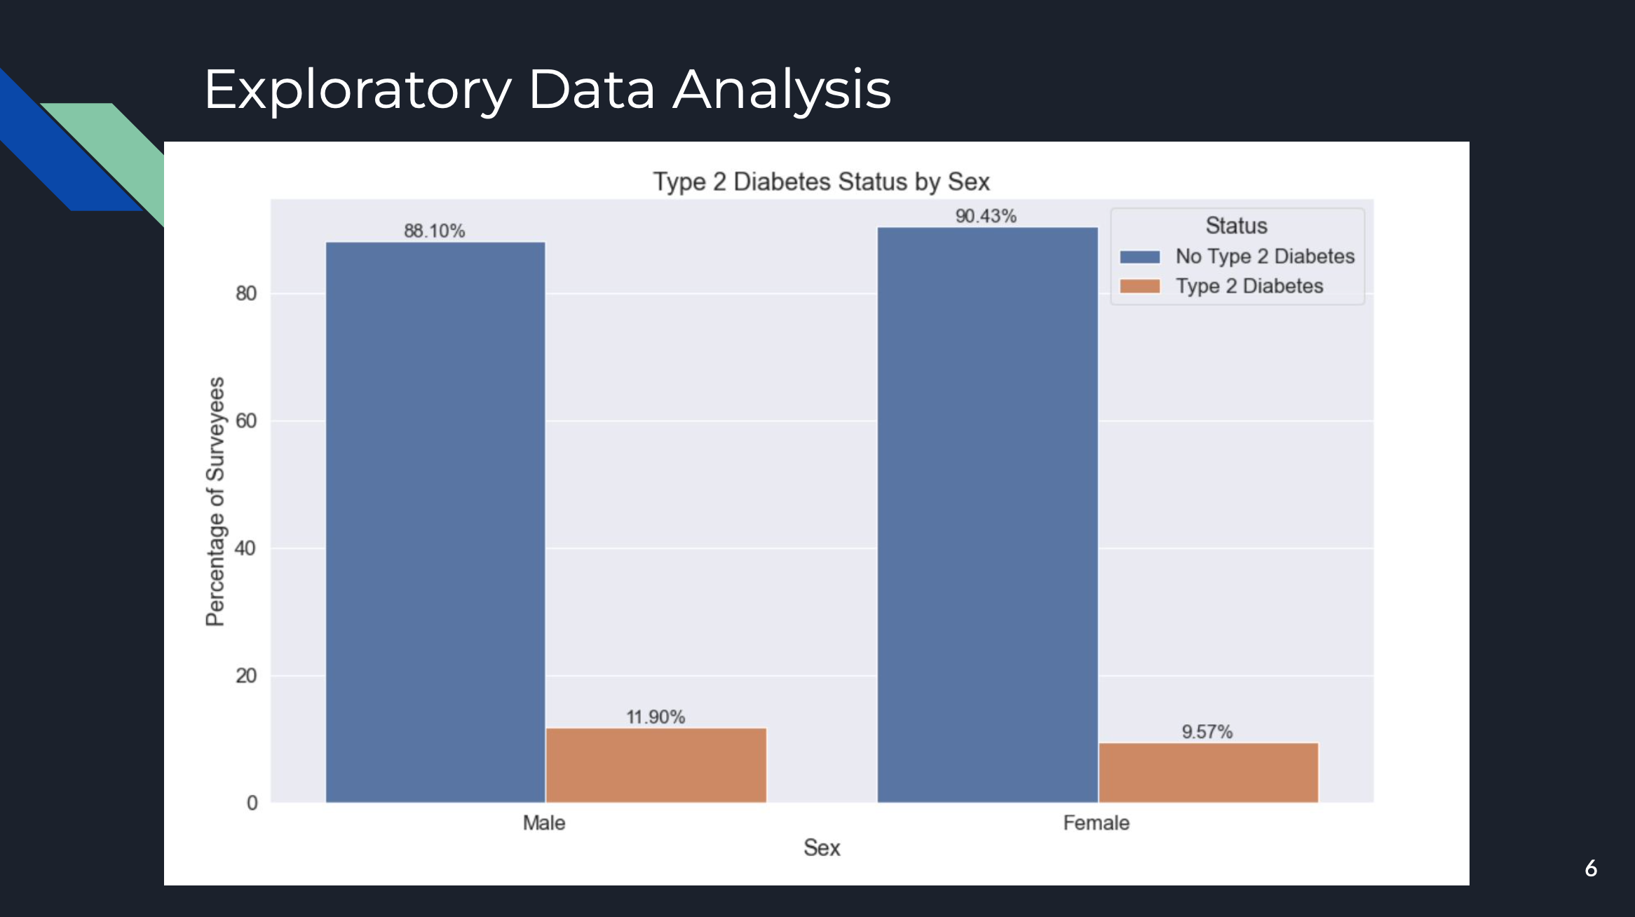
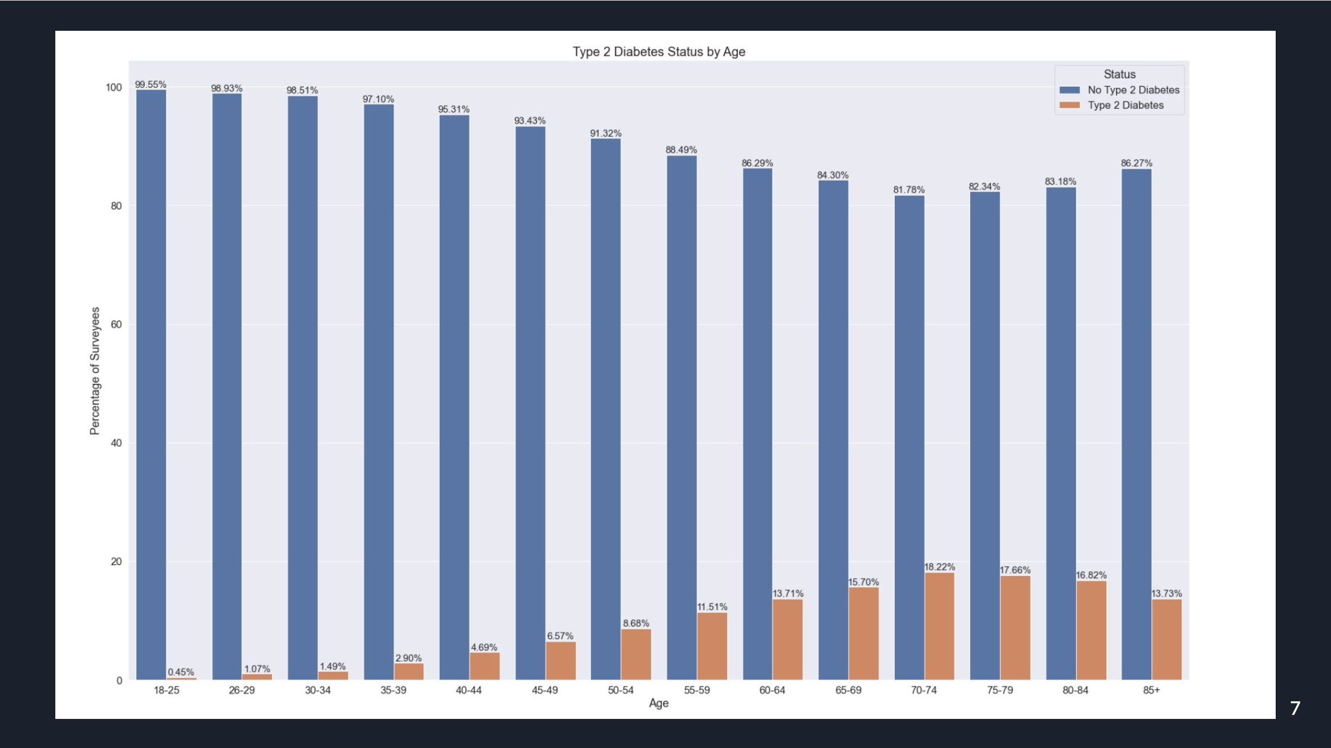
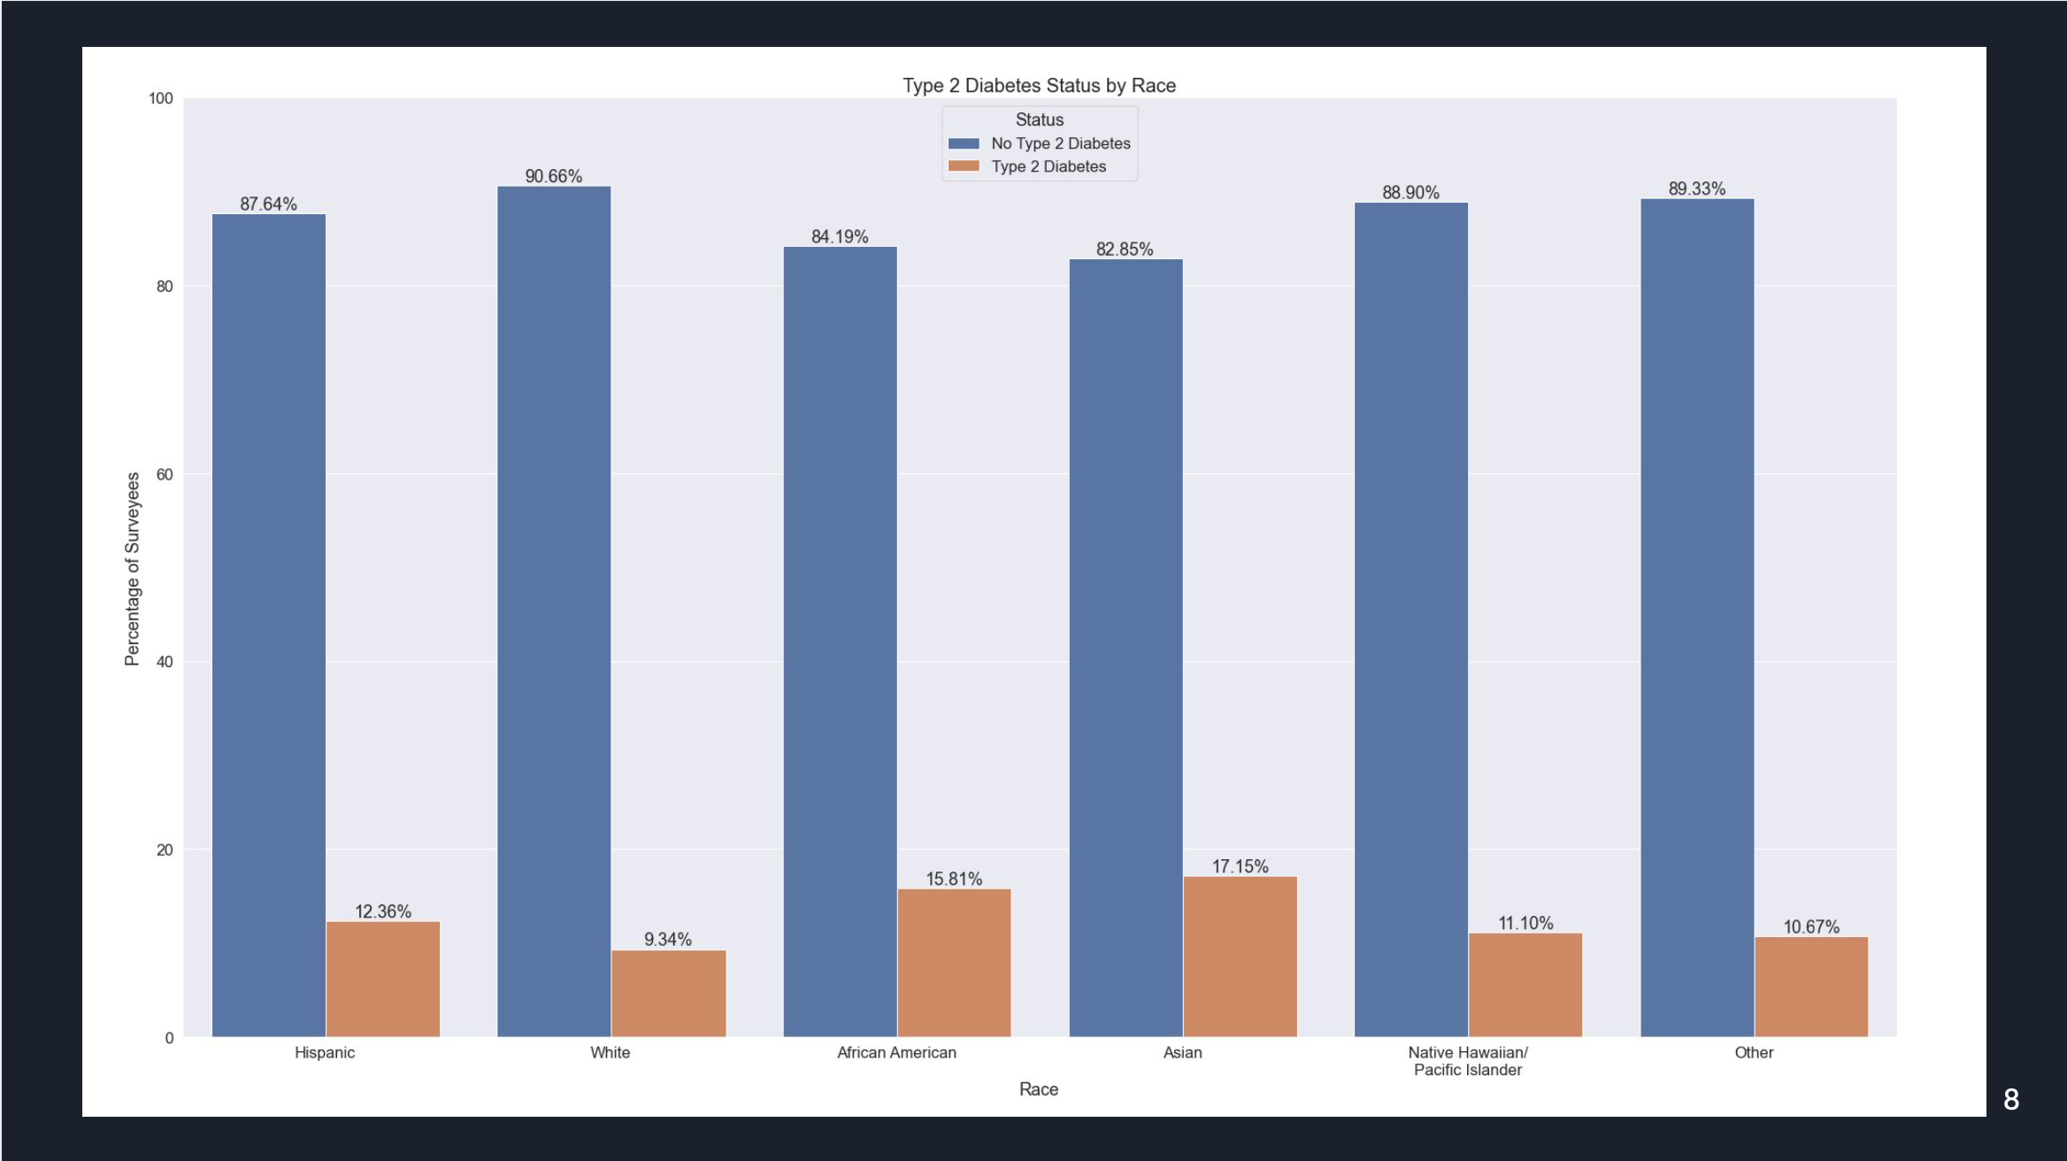
Exploratory Data Analysis
The below charts show the breakdown of Type 2 Diabetes status by sex, age, and race. The data show that there is a relationship between sex, age, and race and Type 2 Diabetes, but the specific factors and level of impact be determined using statistical modeling.

Slide 16
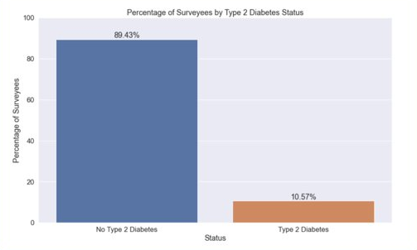
Class Imbalance
A common issue in health data is class imbalance, in which the data contains a far higher proportion of cases negative for type 2 diabetes. If not accounted for properly, this can cause bias.
Ways to deal with Class Imbalance:
Cost-Sensitive Learning
Takes the costs of prediction errors (and potentially other costs) into account when training a machine learning model.
Assigns different costs to the type of misclassification errors.
Synthetic Minority Oversampling Technique
Oversampling method that selects a random sample in the minority class, finds its k nearest neighbors, randomly selects a neighbor, and then creates a synthetic example between the two examples.

Slide 17
Key Outcomes
This analysis identified an accurate model for this type of data and the associated risk factors for type 2 diabetes.
Model combines several other machine learning models to best predict an outcome
Able to use this model on other diabetes data
For this data, XGBoost is the best model
F1 Score (0.8982)
ROC AUC Score (0.8744)
Identified most accurate model for predicting type 2 diabetes
Identified top risk factors for type 2 diabetes
Top 10 features:
Age
Race
Sex
Weight
BMI
High blood pressure
Heart disease
Prediabetes
Diet

Slide 18

BMJ Publication
We are working on submitting a paper on this analysis to the British Medical Journal. If accepted, Accenture will gain major credentials for our work in public health analytics.
3,000-word manuscript
300-word abstract
Reviewed by a scientific panel chosen by BMJ where we submitted 3 reviewer preferences
Shawna Tuli is first author with Vishrut Chokshi, Marty Hodgett, Manish Dasaur, Dalal Sachin, Michelle Smith, Praneet Raj, Bryan S. Price, Erik Kronstadt, Anthony Agbasi, Mei-Chi Chen, Nile Hanov, Jeffrey Vu, Jeffrey Lu, Ella Liang, Kelly Im (UCI) , Brian Wang (UCI), Alvin Zou (UCI) as co-authors

Slide 19
05
Client Engagement Opportunities

Slide 20
How this matters for clients
This analysis shows how public health data can be compiled and analyzed to provide actionable insights for clients.
Develop and deliver a comprehensive public health analytics solution
Combines several different datasets both publicly and privately available that encompasses the many factors in a person’s life
EX: geographical data, employment data, emissions data
Predicts several different health outcomes
Value for clients
Enable clients to reach their strategic goals by approaching public health holistically and innovatively
Empower departments to better utilize their human resources to focus on specific areas
Public Services use case – use for city planning
Health use case – conduct different patient segmentation analyses to create new frameworks, strategies, and processes for patient care

Slide 21
APPENDIX

Slide 22
Class Imbalance
Data is at the heart of AI and data quality is key to successful AI
Ways to deal with Class Imbalance:
Cost-Sensitive Learning
Takes the costs of prediction errors (and potentially other costs) into account when training a machine learning model.
Assigns different costs to the type of misclassification errors.
Synthetic Minority Oversampling Technique
Oversampling method that selects a random sample in the minority class, finds its k nearest neighbors, randomly selects a neighbor, and then creates a synthetic example between the two examples.

Slide 23
Feature Selection
Used a Random Forest Classifier to get the important features for feature selection
Number of features: 785 -> 245
Some of the important features
AB99 - Doctor Ever Told Surveyed To Have Pre-Diabetes
BMI_P - Body Mass Index
WGHT_P – Weight (pounds)

Slide 24
National
How can we continue this project?○Extend our findings to datasets that cover more regions○National Health Interview Survey (NHIS) dataset for nationwide coverage
How to bring this to clients:
Scale to be a comprehensive analytics solution that contains many datasets (not just health either – think census tracts, geographical data, employment data, emissions data – social determinants of health) and determines the risk for a variety of chronic diseases
Value for clients –

Slide 25
Models
K-Nearest Neighbors
Takes the k nearest neighbors of a data point and assigns the data point the same label based on majority rule and clusters the data points into k groups.
Stochastic Gradient Descent
Iterative algorithm that starts from a random point on a function and randomly picks one point at each iteration to travel down its slope until it reaches the lowest points of the function.
Decision Trees
Builds up a set of decision rules in the form of a tree which helps predict an outcome.
Random Forest
Consists of many decision trees and takes the prediction from each tree and selects the final prediction based on majority rule.
XGBoost
Algorithm that combines decision trees and gradient boosting.
Combines the predictions of numerous simple decision trees into one.

Slide 26
Performance Metric Definitions
Accuracy
The proportion of respondents who have or don't have Type 2 diabetes and are correctly classified among the total number of cases examined.
Precision
The proportion of people who have Type 2 diabetes and are correctly classified among all respondents who are predicted to have Type 2 diabetes.
Recall
The proportion of respondents who have Type 2 diabetes and are correctly classified among those who have Type 2 diabetes.
F1 Score
The harmonic mean of precision and recall. The value is between 0 and 1 - the closer the score is to 1, the more accurate the model.
ROC AUC Score
The ROC curve plots the True Positive Rate against the False Positive Rate. The closer the curve is to the top left corner, the better the model is.
AUC stands for Area Under the Curve. The value is between 0 and 1 - the closer the score is to 1, the more accurate the model.
Confusion Matrix
A table used to describe the performance of a classification model on a set of test data for which the true values are known.
Stratified K-Folds Cross-Validation
Splits the training data into k folds with each fold containing a representative ratio of each class.

Slide 27
Performance Metric Equations
Accuracy
(TP + TN)/(TP + FP + FN + TN)
Precision
TP / (TP + FP)
Recall
TP / (TP + FN)
F1 Score
2 * ((Precision * Recall) / (Precision + Recall))

Slide 28
Confusion Matrix
Predicted
 | Don't Have Type 2 Diabetes | Has Type 2 Diabetes
Doesn't Have Type 2 Diabetes | True Negative (TN) | False Positive (FP)
Has Type 2 Diabetes | False Negative (FN) | True Positive (TP)
Actual

Slide 29
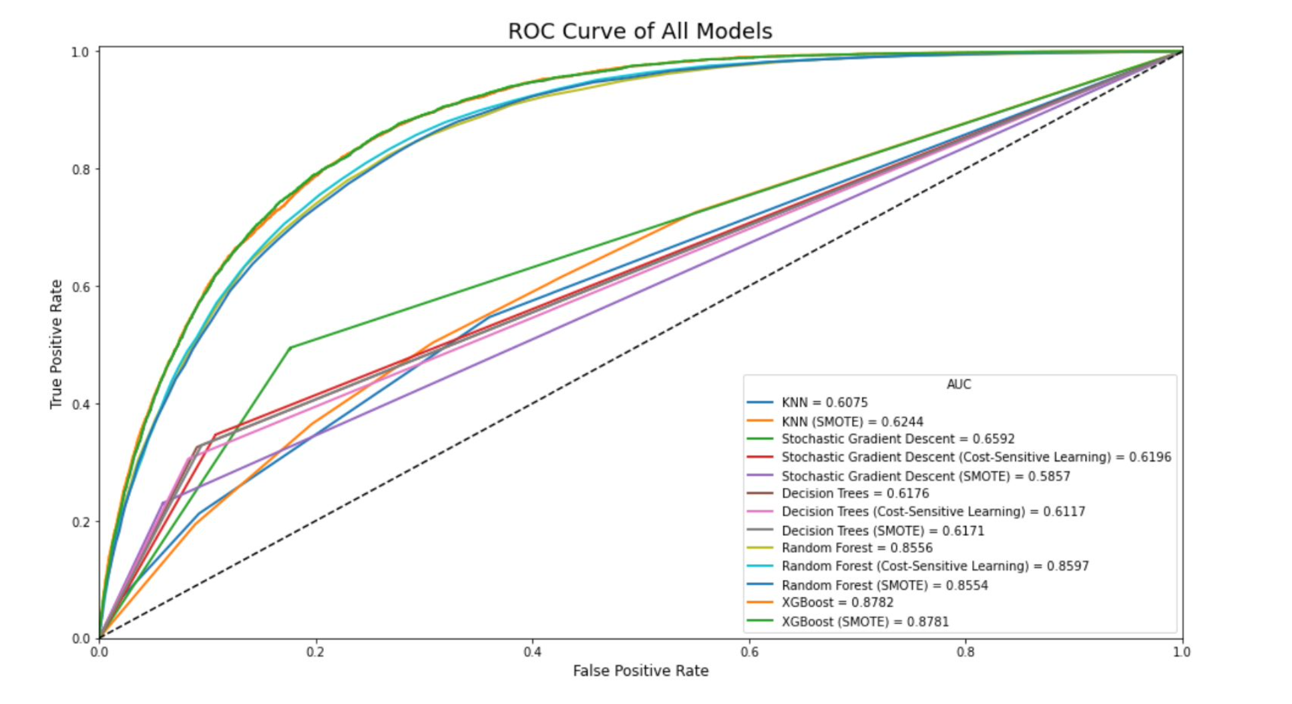
ROC-AUC Curve of All Models

Slide 30
Results Without Cross-Validation
Model | F1 Score | ROC AUC Score
KNN | 0.1075 | 0.6075
KNN (SMOTE) | 0.2437 | 0.6244
Stochastic Gradient Descent | 0.2370 | 0.6592
Stochastic Gradient Descent (Cost-Sensitive Learning) | 0.1083 | 0.6196
Stochastic Gradient Descent (SMOTE) | 0.2624 | 0.5857
Decision Trees | 0.3095 | 0.6176
Decision Trees (Cost-Sensitive Learning) | 0.3031 | 0.6117
Decision Trees (SMOTE) | 0.3074 | 0.6171
Random Forest | 0.0952 | 0.8556
Random Forest (Cost-Sensitive Learning) | 0.0913 | 0.8597
Random Forest (SMOTE) | 0.1481 | 0.8554
XGBoost | 0.3522 | 0.8782
XGBoost (SMOTE) | 0.3605 | 0.8781

Slide 31
Results With Cross-Validation
Model | F1 Score | ROC AUC Score
KNN | 0.8841 | 0.6041
KNN (SMOTE) | 0.6704 | 0.6221
Stochastic Gradient Descent | 0.7178 | 0.6872
Stochastic Gradient Descent (Cost-Sensitive Learning) | 0.7665 | 0.7139
Stochastic Gradient Descent (SMOTE) | 0.8181 | 0.7283
Decision Trees | 0.8468 | 0.6140
Decision Trees (Cost-Sensitive Learning) | 0.8510 | 0.6076
Decision Trees (SMOTE) | 0.8460 | 0.6169
Random Forest | 0.8961 | 0.8533
Random Forest (Cost-Sensitive Learning) | 0.8957 | 0.8582
Random Forest (SMOTE) | 0.8960 | 0.8524
XGBoost | 0.8982 | 0.8744
XGBoost (SMOTE) | 0.8981 | 0.8749

Slide 32
Features Not Included
Data is at the heart of AI and data quality is key to successful AI
Variable | Label | Reason
PUF1Y_ID | Public Use File ID | Participant's ID
AB111 | Admitted to Hospital Overnight or Longer for Diabetes Past 12 Months | Universe = Adults who have diabetes
AB23_P1 | Age First Told Have Diabetes | Universe = Adults who have diabetes
AB114_P1 | Confidence to Control and Manage Diabetes | Universe = Adults who have diabetes
AJ82 | Delayed Prescription for Diabetes | Universe = Adults who have diabetes who cited code/lack of insurance as reason for delay in getting prescribed medicine
AB22V2 | Doctor Ever Told Have Diabetes | May imply the participant already has diabetes
DIABETES | Doctor Ever Told Have Diabetes (Non-Gestational) | May imply the participant already has diabetes
AB81 | Doctor Told Had Diabetes Only During Pregnancy | May imply the participant already has diabetes at the time of pregnancy
AB113 | Have Written Copy of Diabetes Care Plan | Universe = Adults who have diabetes and medical providers developed diabetes care plan

Slide 33
Features Not Included
Data is at the heart of AI and data quality is key to successful AI
Variable | Label | Reason
AB112 | Medical Providers Develop Diabetes Care Plan | Universe = Adults who have diabetes
AB51_P1 | Type 1 or Type 2 Diabetes | Universe = Adults who have diabetes
AB110_P | Visited ER for Diabetes Because Unable to See Own DR | Universe = Adults who have diabetes
AB109 | Visited ER for Diabetes in Past 12 Months | Universe = Adults who have diabetes
AB24 | Currently Taking Insulin | Universe = Adults who have diabetes
DIAMED | Taking Insulin or Pills | Universe = Adults who have diabetes
AB25 | Currently Taking Diabetic Pills to Lower Blood Sugar | Universe = Adults who have diabetes
AB63 | Last Eye Exam Dilated Pupils | Universe = Adults who have diabetes
AB27_P1 | Number of Times Doctor Checked for Hemoglobin A1C Last Year | Universe = Adults who have diabetes and medical providers developed diabetes care plan

Slide 34
Features Not Included
Data is at the heart of AI and data quality is key to successful AI
Variable | Label | Reason
AB28_P1 | Number of Times Doctor Checked Feet for Sores Last Year | Universe = Adults who have diabetes
AB26_P1 | Number of Times Respondent/R's Family/Friend Check Glucose | Universe = Adults who have diabetes
DIABCK_P1 | Number of Times Checking for Glucose/Sugar Per Month | Universe = Adults who have diabetes or sugar diabetes
AB27_P | Number of Times Doctor Checked Hemoglobin A1C Last Year | Universe = Adults who have diabetes
AJ80 | Has Someone at Doctor's Office/Clinic Who Helps Coordinate Medical | Universe = Adults who have usual source of care and has personal doctor and have asthma or diabetes or heart disease
AH102_P | Number of Nights in Hospital Past 12 Months | Universe = Adults who were hospitalized for asthma, diabetes or heart disease during the past 12 months
AH102_P1 | Number of Nights in Hospital Past 12 Months | Universe = Adults who were hospitalized for asthma, diabetes or heart disease during the past 12 months

Slide 35
Features Not Included
Data is at the heart of AI and data quality is key to successful AI
Variable | Label | Reason
WEIGHK_P | Weight - KG | Similar feature to another feature in the dataset
WGHTK_P | Weight - KG | Similar feature to another feature in the dataset
HEIGHM_P | Height - Meters | Similar feature to another feature in the dataset
HGHTM_P | Height - Meters | Similar feature to another feature in the dataset
WHOBMI | Body Mass Index – WHO Definition | Similar feature to another feature in the dataset

